Slide 1
Applets
Session 8

Slide 2
Review
The Abstract Windowing Toolkit (AWT) is a set of classes that allow us to create a graphical user interface and accepts user input through the keyboard and the mouse.
A component is anything that can be placed on a user interface and be made visible or resized.
Commonly used examples of components are textfields, labels, checkboxes, textareas .
Frame and Panel are commonly used containers for standalone applications.
A Panel is generally used to group many smaller components together.
JDK1.2 follows the Event Delegation Model in which the program registers handlers called listeners, with the objects.

Slide 3
Review Contd…
KeyboardFocusManager class was developed to know which component GAINED_FOCUS or LOST_FOCUS. It was added in the JDK 1.4.
Events are dispatched in an orderly manner. One event has to be fully handled before another event can be handled.
Each component has its own set of Keys for traversing.
ContainerOrderFocusTraversalPolicy and DefaultFocusTraversalPolicy are the two standard FocusTraversalPolicy which can be implemented by the client.
Programmatic traversal is also possible by using methods of KeyboardFocusManager class.

Slide 4
Objectives
Define an applet
Differentiate between Java Applications and Java Applets
Create an applet
Identify how parameters are passed to applets
Discuss event handling with Applets
Explain Classes such as
  Graphics class
  Font class
  FontMetrics class
  Color class

Slide 5


Applets
An Applet is a Java program that can be embedded in an HTML page and executed on a Java enabled browser.
Created by subclassing from the java.applet.Applet class
Examples of Java enabled web browsers are Internet Explorer
and Netscape Communicator.

Slide 6
Difference between
Applets and Applications
An applet is basically designed for deploying on the web.
An application is designed to work as a standalone program.
Applets are created by extending the java.applet.Applet class.
There is no such constraint for an application.
Applets run on any browser.
Applications run using Java interpreter.

Slide 7
Difference between
Applets and Applications Contd…
Execution of applets begin with the init() method. Execution of applications begins with main() method.
Applet must contain at least one public class failing which the compiler reports an error. It is not mandatory to declare main() for an applet. In case of application, main() has to be included in a public class.
Output to an Applet’s window is done by using different AWT methods such as drawString(). In case of an application System.out.println() method is used.

Slide 8
Life cycle of an Applet
Life cycle of an object specifies stages the object has to pass right from its creation until it is destroyed.
An applet defines its structure from four events that take place during execution.
For each event, a method is automatically called.

Slide 9
Life cycle of an Applet Contd…
The methods are as follows:
  init(): called during initialization
  start(): starts the applet once it is initialized
  stop(): used to pause the execution of an applet
  destroy(): used to destroy the applet
  The method paint() is used to display a line, text or an image on the screen
  Whenever an applet has to be painted again after it has been drawn once, the repaint() method is used.

Slide 10
Life cycle of an Applet Contd…
Start state
Redraw Applet
Destroy Applet
init( )
Applet Born
start( )
paint( )
stop( )
destroy( )
Initialization state
Applet Working
Applet Displayed
Idle State
Applet Destroyed

Slide 11
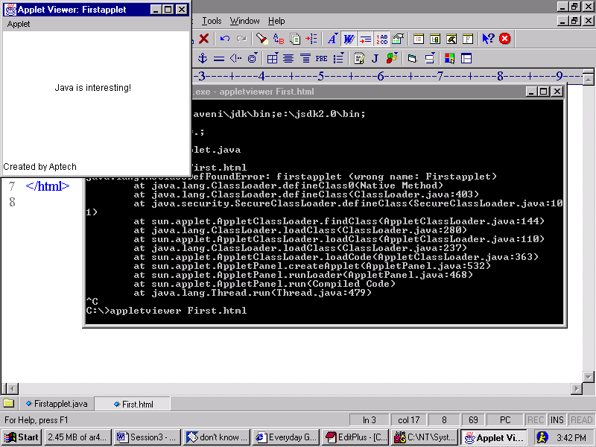
A simple applet
import java.awt.*;
import java.applet.*;
public class FirstApplet extends Applet
{
String str;
public void init()
{
str = "Java is interesting!";
}
public void paint(Graphics g)
{
g.drawString(str, 70, 80);
}
}
Output

Slide 12
Creating an Applet
An applet is compiled using the Java compiler: javac
  javac Firstapplet.java
Create a HTML page to display the applet
  <html>
  <appletcode=Firstapplet width=200 height=200>
  </applet>
  </html>
Then type the following at command prompt:
  appletviewer abc.html where abc.html is the name of
  the html file.

Slide 13
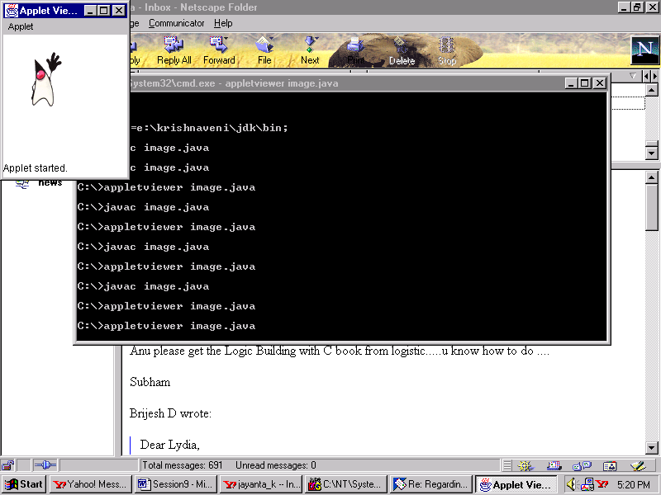
Displaying images using Applets
/*
<applet code = DisplayImage width = 200 height = 200>
</applet>
*/
import java.awt.*;
import java.applet.*;
public class DisplayImage extends Applet
{
Image img;
public void init()
{
img = getImage(getCodeBase(),"duke.gif");
}
public void paint(Graphics g)
{
g.drawImage(img,20,20,this);
}
}
Output

Slide 14
Displaying images using Applets Contd…
To display images, we need to make use of the Image and Graphics classes.
getCodeBase() method gets the base URL of the applet
getImage() method returns an Image object which can be drawn on the screen
drawImage() takes four parameters – Image object, location in terms of x and y coordinates and an object of type ImageObserver

Slide 15
Passing parameters
Parameters allow the user to control certain factors of the applet.
Parameters are passed to the applet using the <param> tag in the HTML file.
Parameter value is retrieved in the applet using the getParameter() method which returns a string.

Slide 16
Example
import java.awt.*;
import java.applet.*;
public class ImageDemo extends Applet
{
Image img;
public void init()
{
String imagename = getParameter("image");
img = getImage(getCodeBase(),imagename);
}
public void paint(Graphics g)
{
g.drawImage(img,20,20,this);
}
}
<html>
<applet code = ImageDemo width = 150 height = 150>
<param name = "image" value = "duke.gif">
</applet>
</html>

Slide 17
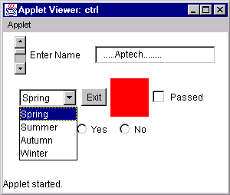
Applets and GUI
Graphical User Interface is used to create a pictorial interface that is easy to work with.
Default layout of an applet is FlowLayout.
The figure below depicts the various controls that can be created.

Slide 18
Handling events with applets
Clicking or pressing the Enter key on GUI components generates an event
While designing applets we need to trap these events and provide suitable actions to be performed in response to each of those events
To handle the events, event handlers are available that must be suitably manipulated
The procedure to be followed when an event is generated are:
  determine the type of the event
  determine the component which generated the event
  write appropriate code to handle the event

Slide 19
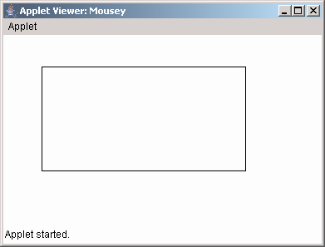
Example
/* <applet code = Mousey width = 400 height = 400>
</applet>*/
import java.awt.*;
import java.applet.*;
import java.awt.event.*;
public class Mousey extends Applet implements MouseListener,
MouseMotionListener
{
int x1, y1, x2, y2;
public void init()
{
setLayout(new FlowLayout());
setBounds(100,100,300,300);
addMouseListener(this);
addMouseMotionListener(this);
this.setVisible(true);
}
public void mouseClicked(MouseEvent e)
{
}
public void mousePressed(MouseEvent e)
{
x1 = e.getX();
y1 = e.getY();
}
public void mouseMoved(MouseEvent e)
{}
public void mouseReleased(MouseEvent e)
{
x2 = e.getX();
y2 = e.getY();
repaint();
}
public void mouseEntered(MouseEvent e)
{}
public void mouseDragged(MouseEvent e)
{}
public void mouseExited(MouseEvent e)
{}
public void paint(Graphics g)
{
g.drawRect(x1, y1, x2-x1, y2-y1);
x2 = 0;
y2 = 0;
}
}
Output

Slide 20
Graphics, Colors, and Fonts
Any GUI based program without images or colors looks dull and lifeless.
To enhance their appearance, it is recommended that we use images wherever possible.
General procedure to draw images would be:
  Obtain the URL or path of the image to be displayed.
  Decide upon the position (coordinates) at which image is to be displayed.
  Supply all these information using an appropriate method.

Slide 21
Graphics class
Drawing operations is accomplished using this class.
Apart from text, it is possible to draw images, rectangles, lines, polygons and various other graphical representations.
Graphics class is a part of the java.awt package.
It has to be imported into the program.

Slide 22
Example
/*
<applet code=Painting width=400 height=400>
</applet>
*/
import java.applet.*;
import java.awt.*;
import java.awt.event.*;
public class Painting extends Applet implements ActionListener,
MouseListener
{
Button bdraw = new Button("Draw Rectangle");
int count = 0,x1,x2,x3,x4;
public void init()
{
BorderLayout border = new BorderLayout();
setLayout(border);
add(bdraw, BorderLayout.PAGE_END);
bdraw.addActionListener(this);
addMouseListener(this);
this.setVisible(true);
}
public void mouseClicked(MouseEvent e)
{}
public void mousePressed(MouseEvent e)
{
x1 = e.getX();
x2 = e.getY();
}
public void mouseMove(MouseEvent e)
{
x3 = e.getX();
x4 = e.getY();
repaint();
}
public void mouseReleased(MouseEvent e)
{
x3 = e.getX();
x4 = e.getY();
repaint();
}
public void mouseEntered(MouseEvent e)
{}
public void mouseExited(MouseEvent e)
{}

Slide 23
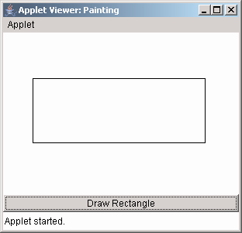
Example Contd…
public void actionPerformed(ActionEvent e)
{
String str = e.getActionCommand();
if("Draw Rectangle".equals(str))
{
count = 1;
repaint( );
}
}
public void paint(Graphics g)
{
if(count == 1)
{
g.drawRect(x1,x2,(x3-x1),(x4-x2));
x3 = x4 = 0;
}
}
}
Output

Slide 24
Font class
java.awt.Font class is used to set or retrieve fonts.
One of the constructor of the Font class is:
  public Font(String name, int style, int pointsize)
    name can be “Times New Roman”, “Arial” and so on.
    style can be Font.PLAIN, Font.BOLD, Font.ITALIC
    pointsize for fonts can be 11,12,14,16 and so on.

Slide 25
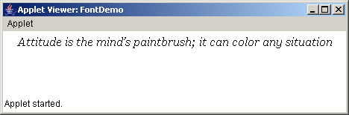
Example
/*
/*<applet code = FontDemo width = 400 height = 400>
</applet>*/
import java.applet.*;
import java.awt.*;
public class FontDemo extends Applet
{
public void paint(Graphics g)
{
String quote = "Attitude is the mind’s paintbrush; it can color any situation ";
Font objFont = new Font("Georgia",Font.ITALIC,16);
g.setFont(objFont);
g.drawString(quote,20,20);
}
}
Output

Slide 26
FontMetrics class
At times, it is necessary to know the attributes of fonts used within a program.
In such a case, the FontMetrics class proves useful.
Commonly used methods of FontMetrics class:
  int stringWidth(String s) – returns full width of string
  int charWidth(char c) – returns width of that character
  int getHeight() – returns total height of the font

Slide 27
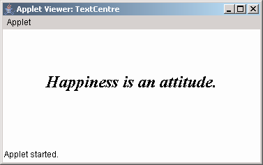
Example
Output
/*
<applet code= TextCentre width=400 height=400>
</applet>*/
import java.applet.*;
import java.awt.*;
public class TextCentre extends Applet
{
public void paint(Graphics g)
{
String myquote = "Happiness is an attitude.";
Font objFont = new Font("Times New Roman" , Font.BOLD|Font.ITALIC , 24);
FontMetrics fm = getFontMetrics(objFont);
g.setFont(objFont);
int numx = (getSize().width - fm.stringWidth(myquote))/2;
int numy = getSize().height/2;
g.drawString(myquote,numx,numy);
}
}

Slide 28
Determining Available Fonts
We should always know which fonts are available on the machine.
We can use a method called getAvailableFontFamilyNames() defined in the GraphicsEnvironment class.
The syntax of the method is as follows:
  String[] getAvailableFontFamilyNames(): returns an array of Strings that contains the names of the available font families.
  Font[] getAllFonts(): returns an array of Font objects for all the available fonts.

Slide 29
Color class
java.awt.Color class is used to add color to applications and applets.
Objects of Color class can be constructed as shown :
  Color a = new Color(255,255,0);
  Color b = new Color(0.907F,2F,0F);
To change or set colors for a component :
  void setColor(Color) of Graphics class
  void setForeground(Color) of Component class ,inherited by various components
  void setBackground(Color) of Component class ,inherited by various components

Slide 30
Summary
An Applet is a Java program that can be executed with the help of a Java enabled browser.
Every user-defined applet must extend the java.applet.Applet class.
A user defined applets inherits all the methods of Applet class.
<applet>..</applet> tags are used within a HTML file to embed a class file.
The default layout for an applet is FlowLayout.
Images can be drawn on an applet by means of the paint(), getImage() and drawImage() methods.
Whenever the user performs an action such as moving the mouse, pressing a key, releasing the key and so on, an event is generated. We can make use of event handler classes and interfaces to handle these events.

Slide 31
Summary Contd…
Event handling in applets in the simplest form can be handled by overriding the
mouseDown(), mouseUp() , mouseDrag() methods.
The Graphics class is used to draw objects like text , lines ovals and arcs on the screen.
The Font class is used to make text look attractive in the output of a Java program.
The FontMetrics class is used to obtain information about a Font.
GraphicsEnvironment class has methods to get information about the available fonts in the system.
The Color class is used to add colors to an application or applet.

